Slide 1
CIS 286 Introduction to Data Structures-Java
Chapter ??
Graphs

Slide 2
Introduction to Graphs
A graph has some vertices
Some (perhaps all or none) of the vertices are connected to each other
Here is an example

Slide 3
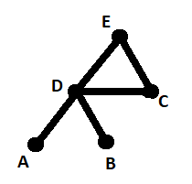
The Sample Graph
In this graph
  A, B, C, D, and E are the vertices
  There are five edges

Slide 4
Applications of Graphs
  There are lots of ideas that come from or lead to applications of graphs
  Here are a few

Slide 5
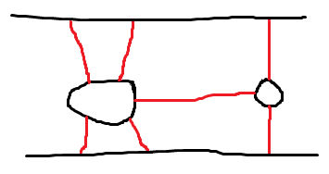
The Königsberg Bridges

Slide 6
The Königsberg Bridges and Graphs
We can draw this as a graph
We label the top bank A
We label the bottom bank B
We label the left island C
We label the right island D

Slide 7
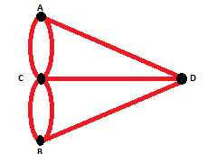
The Königsberg Bridge Graph

Slide 8
The Road Inspector Problem
A person is responsible for keeping the roads in an area in good working (driving?) order
We draw a map of the area
  The cities are vertices
  The roads are edges

Slide 9
The Traveling Salesperson Problem
This is similar to the road inspector problem
The vertices in the graph are cities
The edges are roads connecting the cities
  The edges might be weighted based on the cost of travel
  The edges might be weighted based on the number of miles
  The edges might be weighted based on customer relationships

Slide 10
A Drill Press
You have a sheet of metal
You have a drill press that can be programmed
You want to drill a series of holes in the metal

Slide 11
Erdös Numbers
Paul Erdös was a mathematician
His Erdös number is 0
If you wrote a paper with him, your Erdös number would be 1
If you wrote a paper with someone who wrote a paper with him, your Erdös number would be 2
This continues

Slide 12
Connecting Erdös Numbers to Graphs
Erdös is one vertex in the graph
People who wrote papers with him are connected to him
People who wrote papers with those people are connected to them
The process continues

Slide 13
Similarity Graphs
We want to know how complicated a program is
We need some criteria
For example, we could use
  The number of lines
  The number of calls to methods
  The number of return statements

Slide 14
Are Two Programs Similar?
We can then tell if two programs are similar
Let’s call s the similarity function
  S(P1, P2) = |L2-L1| + |M2-M1| + |R2-R1|
We draw a graph
Each program is a vertex
We then connect programs that have the same similarity

Slide 15
The Knight’s Tour
A knight is a chess piece
It has a specific L-shaped move
Chess boards are 8 x 8
  We will allow any size, but the board must be square
Can we place the knight somewhere so that it can, in successive moves, visit every square on the board?
We want to know which sizes of boards allow this kind of knight’s tour

Slide 16
Connecting the Knight’s Tour to Graph Theory
The squares are vertices
Edges are added if the knight can move from one square (vertex) to another square (vertex)

Slide 17
Paths
There are many special types of paths
  One type of path is a cycle
  A cycle starts and ends at the same point
Two important kinds are of paths are
  Euler cycles
  Hamilton cycles

Slide 18
Connected Graphs
From now on, I assume the graph comes in one piece
We call this kind of graph connected
You can adapt most of what I do to graphs that are not connected
  Just apply it to each piece
    Those pieces are called components

Slide 19
Euler Cycles
An Euler cycle is a path that traverses each edge exactly once
  No edges are omitted
  No edge is traversed twice (or more!)
Not every graph has an Euler cycle
  The Konigsburg Bridge graph doesn’t

Slide 20
Finding an Euler Cycle
If a graph has an Euler cycle, every vertex has an even number of edges incident on it
Interestingly, the reverse is true also:
If every vertex in a graph has an even number of edges incident on it, then the graph has an Euler cycle

Slide 21
Hamiltonian Cycles
A Hamiltonian cycle is a path that
  starts and ends at the same place
  Visits every vertex exactly once

